Slide 1





Annual Interagency Accessibility Forum
Beyond Compliance: Building a Culture of Digital Accessibility
November 7-9, 2023
Government-wide IT Accessibility Program Recent Activities Update
Andrew Nielsen, Mike Horton, Kristen Smith-O’Connor, Alex Wilson

Slide 2
Agenda
Introductions
Government-wide IT Accessibility Program: Who are we and what do we do?
Update: 2023 Government-wide Accessibility Assessment (GWAA)
Update: ICT Testing Baseline Portfolio
Update: IT Accessibility Policy Framework
Update: OpenACR
Update: Section 508.gov (Content Gap, Training, Outreach)
Update: FY2024 Planned Activities

Slide 3




Intros & What is the Gov-wide IT Accessibility Program
Who we are
Our Mission
How we execute our Mission

Slide 4
Government-wide IT Accessibility Assessment (GWAA)

Slide 5
Government-wide Accessibility Assessment (GWAA): Background
In Section 752 of the 2023 Congressional Appropriations Act, Congress stipulated that Office of Management and Budget (OMB), GSA and the U.S. Access Board would report on governmentwide accessibility. The following items were mandated:
100 days after enactment provide questions/metrics agencies must report on
225 Days after enactment (NLT 11 August), agencies must respond
365 days after enactment (NLT 29 December), must provide the following:
A comprehensive assessment by agency and government-wide generally of compliance to accessibility standards
A detailed description of actions and efforts that GSA took to support compliance at agencies over the past year and planned efforts in the next year
A list of recommendations to Congress to help support accessibility compliance

Slide 6
Government-wide Accessibility Assessment (GWAA): Criteria
43 Accessibility Maturity Questions
Questions focused on assessing maturity and health of agency accessibility. Categories are:
IT Accessibility Program Office
Policies, Procedures, and Practices
Acquisition and Procurement
Technology Lifecycle Activities
Testing and Validation
Communications
Content Creation
Training
Human Capital, Culture and Leadership
40 Conformance Questions
Questions focused on specific performance metrics for: web, hardware, software, documents, selected enterprise applications, and targeted program outcomes
22 General Information Questions
Questions collecting general and background information on the program, including: federal FTEs, contracting support, financials, task organization, and complaints, among others
For all assessment information: section508.gov/section-508-assessment/

Slide 7
Government-wide Accessibility Assessment (GWAA): Expected Report Contents
Analysis based on objective, self-reported data both government-wide and by respondent in terms of compliance to Section 508
Overarching recommendations for government and respondents
Recommendations according to how respondents are faring with Section 508 compliance
What GSA has done in the past year and is planning to do in the next year to help agencies with Section 508 compliance
One page for each respondent showing highlights of maturity and conformance
The Assessment report is currently in development and all data and results are pre-decisional

Slide 8
ICT Testing Baseline Portfolio

Slide 9
ICT Testing Baseline Portfolio: The Portfolio
Section 508/WCAG 2.0 AA
What to Test
ICT Testing Baseline
Establishes the foundation for consistent test results
Validation of test processes for alignment
Will eventually include Baselines for all ICT covered by Section 508
Completed: Web
Draft: electronic documents
Planned: software, hardware, etc.

Slide 10
ICT Testing Baseline Portfolio: A Test Process
ICT Testing Baseline
HOW to test (Test Tools)
Test Process

Slide 11
ICT Testing Baseline Portfolio: Web Baseline Update
Release planned for FY24 Q2
Image tests defer to author to determine meaningful or decorative images
New test for User Controls covers SC 4.1.2 more accurately
WCAG 2.2
Understanding articles and Parsing
All Baselines page
Baseline Alignment Framework continues to be developed

Slide 12
ICT Testing Baseline Portfolio: New Documents Baseline
SMEs: Accessible Electronic Documents Community of Practice (AED COP)
Baseline for Web template
Same 508 requirements as Web (except 4 WCAG SCs)
Edited terminology for documents
Covers any document format
Office, PDF, etc.
Expected release of the new documents baseline is FY24 Q2

Slide 13
Accessibility Policy Framework

Slide 14
IT Accessibility Policy Framework: Development Process
Design Policy Assessment Matrix/Criteria
Create Accessibility Policy Framework
Conduct Outreach
Revise Framework
Develop Draft Recommended Language
Post All Materials to Section508.gov

Slide 15
IT Accessibility Policy Framework: Development Process (2)
1. Policy Framework Overview & Introduction Materials
2. Policy Assessment Templates and Instruction Guides
3. Recommended Accessibility-Related Language by Topic & Subtopic
IT Accessibility Policy Analysis Framework

Slide 16





IT Accessibility Policy Framework: Going Forward
Garner external stakeholder feedback on the tool
Update recommended language, templates and analysis materials as required based on feedback
Identify potential pilot partners
Brief to partners, align pilot assessments and assist in pilot assessments (as required)
Iterate and revise framework based pilot results

Slide 17
OpenACR

Slide 18

OpenACR: The Case for a Machine-Readable ACR
Accessibility Conformance Reports (ACRs) often in MS Word or PDF formats
But accessibility information is not in form data
Data is tied to the document container
Difficult to evaluate, search, and compare
Difficult to share details
Static snapshot of accessibility at the time of retrieval
Existence of an ACR does not guarantee product accessibility
Potential discrepancies between ACR claims and actual conformance
Difficult to understand impact of non-conformance on users

Slide 19
OpenACR: What is it?
Part 1
The OpenACR data schema for a machine-readable ACR:
Buyers can more easily compare accessibility of different solutions
Managers gain insights into potential interface limitations
Executives more easily assess risks associated with accessibility issues in portfolio of ICT products
Part 2
The OpenACR Editor - a user-friendly interface to:
Create machine-readable ACRs in the OpenACR format
Validate, and edit previously-created ACRs
Export and share machine-readable data
View ACR reports in HTML

Slide 20
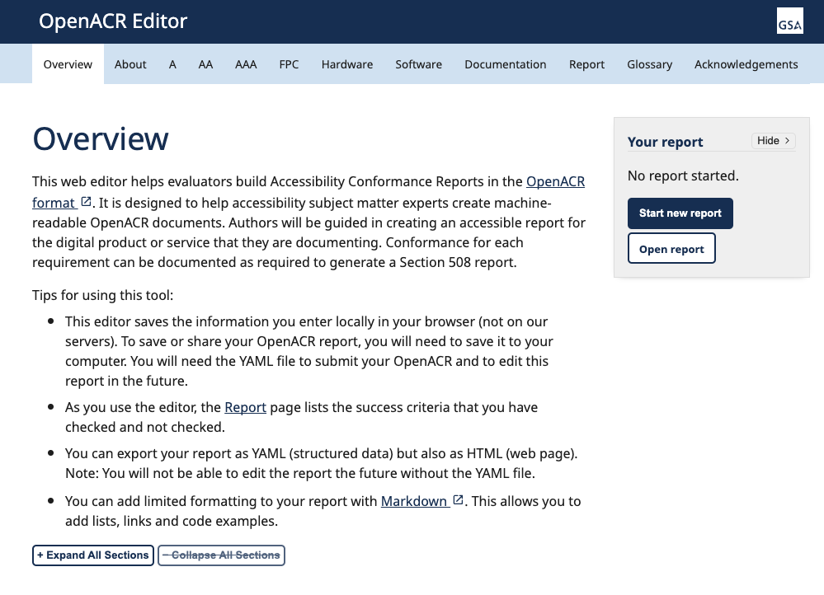
OpenACR: Create a Machine-Readable ACR with the OpenACR Editor
Start from scratch, or edit a previous ACR (in the OpenACR format)
Select report type and catalog (i.e., specific standards)
Product, author, and vendor information
Report version, notes, and evaluation methods
Conformance by standard
View report
Download report (HTML) and data (YAML)

Slide 21
OpenACR: Contribute
OpenACR welcomes input, feedback and contributions from the community
Submit and track issues in GitHub repositories
Updates to catalogs and/or schema
Bug fixes
Editorial changes
Provide feedback via section.508@gsa.gov
Note: All contributions released under the reuse policy for works produced by the federal government; as a product of the federal government, OpenACR is not protected by copyright and is in the public domain.

Slide 22
Section508.gov

Slide 23

Section508.gov Content Gap Analysis
Phase 1: Internal Data Collection
Conduct internal discussions to determine stakeholders, personas and potential needs
Phase 2: External Data Collection
Conduct a range of interviews, focus groups and surveys to gather external feedback
Phase 3: Analysis
Combine internal and external data to determine list of stakeholder needs and aligned gaps on Section508.gov
Phase 4: Development and Redesign
Create new or update current pages to address gaps using internal and external content creation
Status: Complete
Status: Initial Iteration Complete
Status: Complete
Status: In Progress

Slide 24
Section508.gov Training Courses and Continued Outreach
Training List refresh
News and update feature for training
ART Training
Additional partnerships to offer our training (likely through additional Memorandums of Understanding (MOUs)
Bi-monthly ITACM in coordination with US Access Board Webinars
Coordination with ACOP Education Sub-committee for a more curriculum based approach
Discussion for next IAAF (co-hosts wanted!)

Slide 25
Upcoming Efforts

Slide 26
Selected Upcoming FY24 Activities
Update Criteria and release for FY24 Assessment Report
OpenACR adoption and Repository development
Accessible procurement tools enhancements
ICT Baseline Portfolio expansion
Additional Training Courses
Continued Government-wide Coordination
Accessibility Policy Framework expansion

Slide 27
Questions?

